Slide 1
Engineering Role(s) Map
Matt Mosher

Slide 2
Proposed Role Mapping
# | Current Role | Target Role
1 | Dev/ QA/ Automation Tester | Engineer
2 | Team Lead/ Dev Lead/ QA Lead/ SA Lead | Tech Lead
3 | Business Analyst/ UAT | Product Owner
4 | Project Manager/ SCRUM Master | SCRUM Master
5 | Delivery Lead / Project Manager / Program Manager | Delivery Lead / Engineering Manager
6 | Release Manager / Project Manager | Release Train Engineer (RTE)
7 | Delivery Manager | Value Stream Engineer
8 | Portfolio Lead/ Delivery Director | Portfolio Lead/ Delivery Director
9 | System Architect | System Architect
10 | Enterprise Architect | Enterprise Architect
11 | PMO, Project Sponsor, Sr. Management | Program Portfolio Management
12 | Functional SME | Travellers / Functional SME
13 | UI/UX (Optional) | UI/UX (Optional)
14 | System Testing Team | System Team (Optional)
15 | CI / CD Team / Deployment Team | DevOps (Optional)
16 | Business Owners | Product Manager
17 | Business Sponsors | Business Sponsors

Slide 3
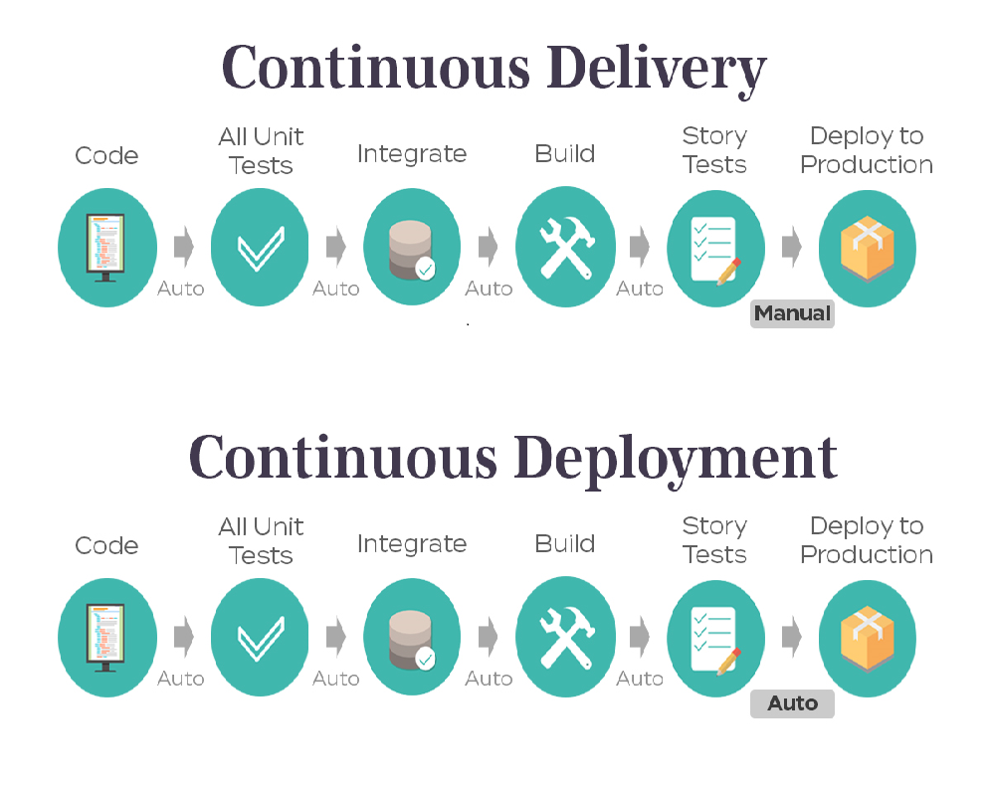
What do I need – Engineer (Foundation)
“Expectations and Hands-on role play”
Technology Stack
Knowledge of development language
Understand E2E Application functional flow
Work in agile team
Have the ability to build/ test a user story
Understand customer and business needs
Understanding of development language
Able to help in testing of product in controlled, real situations before going live
Trainings
Agile Essentials | OSAM
Testing process & Test Planning | CA Agile tool for end to end
Basic knowledge of DevOps Tools and CI-CD
Other Skills
Communication | Team work
Defect management Tracking
Domain
Basic Knowledge of PBM domain

Slide 4
What do I need – Engineer (Advance)
Technology Stack
Knowledge of development language( Services an UI)
Knowledge of Database
APIs | Version Control(SVN,CVS,GIT)
“Expectations and Hands-on role play”
Work in agile team
Expertise in development language
Understand application flows – In-depth knowledge of what is being developed
Have the ability to design/ build/ test a full vertical slice of a user story.
Understand customer and business needs
Should involve in end-to-end 1 PI.
Able to help in testing of product in controlled, real situations before going live
Able to build Solutions using relevant CI- CD tools
Trainings
Quality Engineering Processes | Requirements Traceability & Test scenarios / Test suits
Acceptance Test Driven Development | CI/CD tools - Jenkins, XLDeploy, GitHub
CA Agile tool for end to end | Performance Testing tools – Load runner and Jmeter
Understand and build solutions using Dev Tools and CI-CD
Other Skills
Written/Verbal Communication | Team work
Analytical and problem-solving skills | Defect management Tracking
Domain
E2E Knowledge of Functional flow
PBM 202 | HDP

Slide 5
What do I need – Engineer (Full Stack Developer)
Technology Stack
Application technology Stack ( technology layers – Services and UI)
Knowledge of Testing Tools and Framework
Database and Development language
APIs | Version Control(SVN,CVS,GIT)
“Expectations and Hands-on role play”
Work in agile team
Understand application flows – In-depth knowledge of what is being developed
Have the ability to design/ build/ test a full vertical slice of a user story (including automated unit and functional/acceptance test).
Understand customer and business needs
Expertise in development language and should be able to provide technical inputs
Able to help in testing of product in controlled, real situations before going live
Should involve in end-to-end 1 PI and take end to end accountability for design/build and test
Able to build Solutions using relevant CI- CD tools
Participate in the test automation - Execute and Maintain existing automation
Trainings
Quality Engineering Processes | SSMO Process
Tools Knowledge | Test Automation Process (Selenium, etc.)
CA Agile tool for end to end
Expert in building and automate solutions using Dev Ops Tools and CI-CD
Other Skills
Written/Verbal Communication | Team work
Analytical and problem-solving skills | Defect Management Tracking
PBM Domain
E2E Knowledge of Functional flow and overall Architecture
PBM 202 | HDP

Slide 6
Trainings for Engineer (Full Stack Developer)
Training | Specific Area
SSMO Processes - Day 1 | SSMO Orientation
SSMO Processes - Day 2 | Incident Management Process
SSMO Processes - Day 2 | Warroom process (what is war room, how to open war room, understanding of war room processes, roles and responsibilities)
SSMO Processes - Day 2 | War room notification process & High Priority Incident Notificatio Process
SSMO Processes - Day 3 | Problem Management Process
SSMO Processes - Day 3 | Change Management Processes
SSMO Processes - Day 4 | Tableau Metrics
SSMO Processes - Day 4 | Health Assessment Dashboard
SSMO Processes - Day 5 | Offshore restrictions
SSMO Processes - Day 5 | Peak season readiness
Quality Engineering - Day 1 | Overall testing process & Test Planning
Quality Engineering - Day 1 | Requirements Traceability & Test scenarios / Test suits
Quality Engineering - Day 2 | System & Regression testing processes
Quality Engineering - Day 2 | UAT testing processes
Quality Engineering - Day 3 | Performance Testing
Quality Engineering - Day 4 | Acceptance Test Driven Development
Quality Engineering - Day 5 | Test Automation Process (Selenium, etc.)
Tools - Day 1 | Basic UNIX commands
Tools - Day 2 | Service Now
Tools - Day 2 | TWS & Job Monitoring
Tools - Day 2 | Enterprise Service Catalogue
Tools - Day 3 | Understanding of Monitoring tools - Splunk, HPBSM, New Relic, Dynatrace, etc
Tools - Day 4 | Testing tools & frameworks
Tools - Day 4 | Performance testing tool - Laodrunner and Neoload
Tools - Day 5 | CA Agile tool for end to end
Tools - Day 5 | Understanding of CI/CD tools - Jenkins, XLDeploy, GitHub

Slide 7
What do I need – Tech Lead
Technology Stack
Application technology Stack ( technology layers – Services and UI)
Knowledge of source/version Control(SVN,CVS,GIT)
Knowledge of Database
Knowledge of testing tools and framework
“Role Expectations and Hands-on role play”
Work in agile team
Define best practices
knowledge of software development processes and procedures to understand his team needs
Understand customer and business needs
Expertise in development language
Identifying and owning architectural and other technically based risk, escalating to the Project Manager as appropriate
Tech Lead spends 80% of time on engineering activities and 20% on people management.
Contribute to design and code Reviews. Should review at least 10 stories and come up with feedback
Accountable for the delivery outcome.
Help team or individual to clarify their technical queries .
Trainings
OSAM | CA Agile tool for end to end
Performance Testing tools – Load runner and Jmeter | Architecture & Design Patterns
Acceptance Test Driven Development
Expert and build solutions using dev Ops tools and CI-CD
Other Skills
Proactive Communication | Analytical and Problem solving
Team Work
Domain
Dependent application knowledge and their integrations
E2E Knowledge of Functional Areas and over all architecture

Slide 8
QE – Foundation Level
“What do I need to be at QE Foundation level?”
Development Language
Java | VBScript
Test Automation Tool
Rational Functional Tester | HP UFT
Selenium | Cucumber
Perfecto / Appium | SOAP UI / API Test
Cyara | Ab-initio
Have knowledge on one of topics from each areas
“Role Expectations and Hands-on role play”
ALM Tools
HP ALM | Rational CLM
CA Agile Central / Rally
Engage early in development lifecycle
Understand Agile concepts
Understand application flows – In-depth knowledge of what is being tested
Participate in the test automation - Execute and Maintain existing automation
Develop simple automation scripts
Understand and identify test data needs
QA Processes
OATS | Risk based Testing
OSAM – Mandatory
PBM Domain
PBM 101 | HDP
Formulary | Rxclaim
Clinical

Slide 9
QE – Practitioner Level
QE - Practitioner
“What do I need to be at QE Practitioner level?”
Development Language
Apply development language learnings
Continuous Automation Tool
Apply Test Tool Learnings
Maven | Test NG
Jenkins | Virtualization/ Dockers
Cucumber | LeanFT
On the job and class room learnings
Apply Foundational level learnings - complete 2 test automation development project (~100 test scripts)
Learn application technology stack
Learn continuous automation tools
Technology Stack
Application technology Stack ( technology layers)
APIs | Jobs
“Role Expectations and Hands-on role play”
Processes
ATDD | BDD
Agile Metrics
Work in agile team
Engage early in lifecycle. PI Planning, Story writing, Acceptance criteria definition
Understand complex application flows
Pair working – Dev and QE to develop In-sprint and continuous automation
Basic debugging – application log analysis, job runs etc.
PBM Domain
PBM 202 | E2E functional flows

Slide 10
QE – Expert Level
QE - Expert
Development Language
Apply development language learnings
“What do I need to be at QE Expert level?”
Continuous Automation Tool
Apply Test Tool Learnings
Apply Continuous Automation tool Learning
Automation Frameworks
Strong knowledge on One or more test automation tools
Strong knowledge on application architecture
Learn Developing and maintaining frameworks
Technology Stack
Application technology Stack ( technology layers)
“Role Expectations and Hands-on role play”
Processes
Test Strategy | Test Env Management
Test Data Management | E2E – Enterprise Test
Test Pyramid / Strategy definition
Tool selections and Automation framework development & Setups
Continuous automation implementations
Integrating test automation with CI pipeline
Define best practices
Mentoring and coaching foundational and practitioner QEs
PBM Domain

Slide 11
What do I need - Scrum Master
Agile Framework
Scrum | Kanban
XP | Lean
“Role Expectations and Hands-on role play”
Understand Agile concepts
Engage early in lifecycle. PI Planning, Story writing, Acceptance criteria definition
Basic knowledge of software development processes and procedures to understand his team needs.
Help team or individual to clarify goals and actions to achieve them.
Able to remove the impediments for the scrum team
Arranged daily stand-up meetings, facilitate meetings, schedule meetings, demo and decision-making processes in order to ensure quick inspection and proper use of adaptation process.
Helps product owner to make the product backlogs in good shape and make them ready for the next sprint.
Trainings
OSAM | CA Agile tool for end to end
Impactful Communication | Scrum Master
Acceptance Test Driven Development
Expert in Agile concepts and their execution
Other Skills
Proactive Communication | Presentation Skill
Risk and Issue management | Team work
Analytical and problem-solving | Defect management Tracking
Agile Metrics(Burndown , EVC etc.
Domain
E2E Knowledge of Functional Areas
PBM 101 | HDP
Formulary | Rxclaim
Certifications( Good to Have)
PSM/CSM

Slide 12
What do I need – Product Owner
Agile Framework
Scrum | Kanban
XP | Lean
“Role Expectations and Hands-on role play”
Trainings
OSAM | CA Agile tool for end to end
Impactful Communication
Understand Agile concepts
Engage early in lifecycle. PI Planning, Story writing, Acceptance criteria definition
Basic knowledge of software development processes and procedures to understand his team needs.
Understand the business, the customer, and the technical capabilities
Define the business vision for the project
Communicate and promote the business vision to all interested parties
Monitor progress of the project in line with the business vision
Agile Techniques and Processes
Continuous Integration | ATDD/TDD
Good grasp of the key technical pieces | SDLC
Other/Business Skills
Communication/Presentation skills | Prioritization Skills
Risk and Issue management
Domain
Application knowledge and overall Architecture
E2E knowledge of Business scope and Product lifecycle
Certification ( Good to Have)
CSM | CSPO

Slide 13
What do I need – Engineering Manager
Technology stack
Understand technical landscape stack and current technologies available
“Role Expectations and Hands-on role play”
Trainings
OSAM | Java/J2ee
LOB and Cross LOB Overview | Architecture & Design Patterns
Impactful Communication | Managing Development
Knowledge of software development processes and procedures to understand his team needs
Manage multiple scrum teams.
Communicating with senior management and the project governance authorities
Monitoring progress against the baselined project plans
Get engaged in feature walkthrough, grooming, capacity planning, story sizing, scoping, sprint demo, rally reporting (burndown charts,) etc.
Participate in PLM activities
Should come up with migration approach and suggestions“
Should own end-to-end delivery for 1 PI.
Communicate Sprint Planning, Release Planning, Risks effectively to stake holders
Facilitates and guides the work of all of the Sprint commitment and Features delivery. Provides technical and domain specific support to team. Helps team in spotting challenges early and re-plan OR re-prioritization.
Nice To Have :
Participate in design, architecture review and come-up with at least one suggestion in following areas
Performance optimization feedback
Down stream and up-stream integrations optimization
Minimizing production outages
Processes
OSAM | SDLC
ATDD | TDD/BDD
Application over all architecture | Integration approach followed for up-stream and down-stream applications
Other Skills
Written/Verbal Communication Presentation skills
Decision Making and Leadership skills
Knowledge of Project Management , Documentation and Process Improvement
Domain
Dependent application knowledge and their integrations
E2E Knowledge of Functional Areas

